Slide 1
ORACLE Technical Session:
SQL Foundation
Prepared and Presented by Sujan Dasgupta
© 2008 Australian Administration Services. All rights reserved. Confidential.

Slide 2
Agenda
Introduction to database concepts
Introduction to SQL
SQL commands
Functions
Lunch
Joins
Advanced SQL
Examples of SQLs
Writing better and effective SQLs
Q&A
© 2008 Australian Administration Services. All rights reserved. Confidential.

Slide 3
aaspire central uses Oracle Database
aaspire central runs on a ORACLE 10g Database
Oracle Database is one of the first commercialised relational database systems available since 1979.
Oracle 10g Database is a Grid enabled Object Relational Database Management System (ORDBMS)
Oracle 10g can handle many types of data other than object relational (traditional structured) data including documents, spatial, multimedia and messages.
Can support up to 512 exabyte (512m TB) and 2,147,483,638 users
© 2008 Australian Administration Services. All rights reserved. Confidential.

Slide 4
What is Grid enabled Object Relational Database Management System?
Oracle 10g can be deployed across multiple servers that can be dynamically configured based on load – just like an electricity grid
Object oriented features include
  User defined datatypes and objects
  Java stored procedures
  Brings object oriented progamming into relational model
Relational Database Concept is based on the model proposed by Dr. E. F. Codd which has the following components:
  Collections of objects or relations that store the data
  Set of operators that can act on the relations to produce other relations
  Data integrity for accuracy and consistency
© 2008 Australian Administration Services. All rights reserved. Confidential.

Slide 5
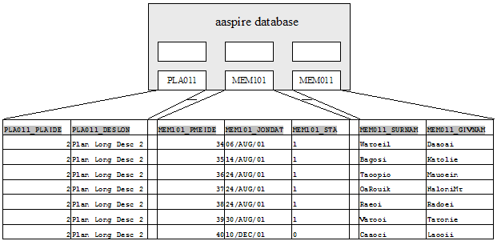
Relational Database
A relational database uses relations or two-dimensional tables to store information
© 2008 Australian Administration Services. All rights reserved. Confidential.

Slide 6
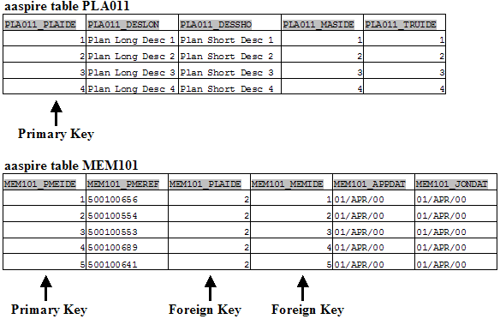
Relating multiple tables
Each row of data in a table is uniquely identified by a Primary Key (PK).
Data can be logically related between two tables using one or many Foreign Keys (FK).
© 2008 Australian Administration Services. All rights reserved. Confidential.

Slide 7
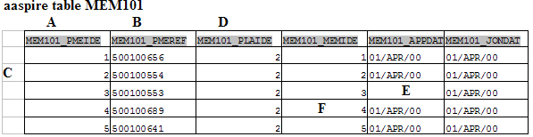
Relational Database Terminology
A Column or attribute containing the Plan member Id which is the primary Key – is not null and unique.
A Column that is not a key value and has data related to member reference.
A Row or a tuple representing all data required for a Plan Member.
Column containing Plan Id, which is a Foreign Key and refers to the primary key of the Plan table PLA011.
The application date field can have no value and is called a Null Value field. Do not use null to represent a value of zero or blank space, because they are not equivalent.
A Field can be found in the intersection of a row and a column and has only one value.
© 2008 Australian Administration Services. All rights reserved. Confidential.

Slide 8
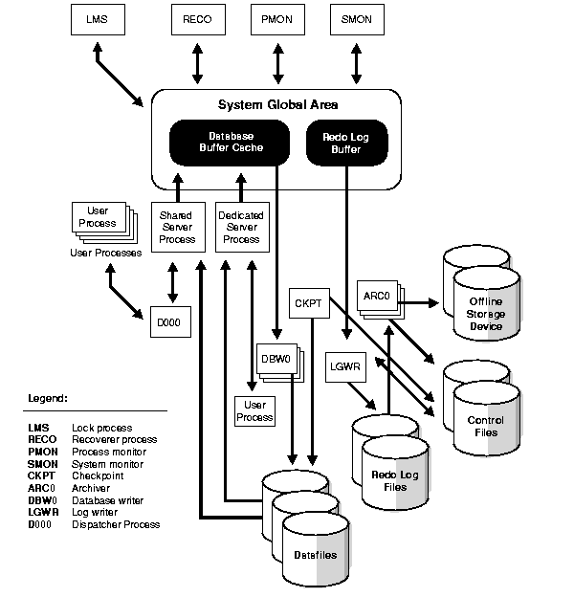
Oracle RDBMS Implementation
Two main components – server Instance and Database
Server instance consists of the memory structure and the background process
Database consists of the physical and logical structures that contains the data.
Data is owned by a Schema like ATU_DATA,ATU_CODE, ATU_SSD
© 2008 Australian Administration Services. All rights reserved. Confidential.

Slide 9
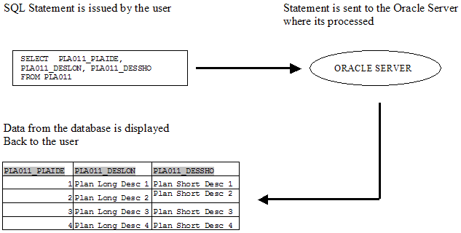
Communicating with the RDBMS using SQL
SQL or Structured Query Language is a special-purpose language used to define, access, and manipulate data.
SQL is nonprocedural, meaning that it describes the necessary components and desired results without dictating exactly how those results should be computed.
© 2008 Australian Administration Services. All rights reserved. Confidential.

Slide 10
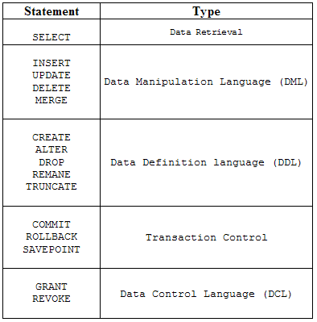
SQL Statement Classification
SQL Statements can be classified into the following types
© 2008 Australian Administration Services. All rights reserved. Confidential.

Slide 11
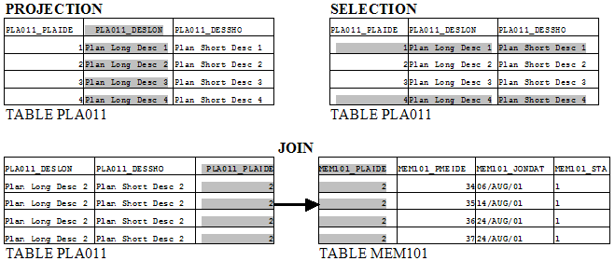
Retreving Information From Database
SELECT statement is used to retrieve information from the database.
SELECT Statement does one of the following:
  Projection : choose one or more columns in a table
  Selection : choose one or more row in the table based on requirement
  Join : display data belonging to more than one table
© 2008 Australian Administration Services. All rights reserved. Confidential.

Slide 12

Guidelines for writing SQL statements
Aim is to write valid SQL statements that are easy to read and edit. Following guidelines will help you
  SQL statements are not case sensitive, unless indicated
  SQL statements can be entered on one or many lines
  Keywords cannot be split across lines or abbreviated
  Clauses are usually placed on separate lines for improved readability and ease of editing
  Indents should be used to make the code more readable
  You could use Uppercase for Key words and lower case for all other words
© 2008 Australian Administration Services. All rights reserved. Confidential.

Slide 13
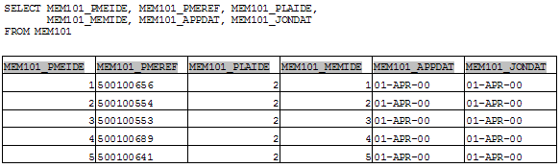
Basic SELECT Statement on a single table
SELECT identifies the columns and FROM identifies the table
The rows returned by the database are known as a result set.
The Oracle database converts the column names that you specify into their uppercase equivalents.
Character and date columns are left-justified;
Number columns are right-justified.
© 2008 Australian Administration Services. All rights reserved. Confidential.

Slide 14
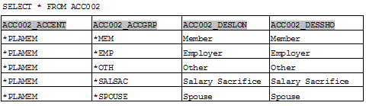
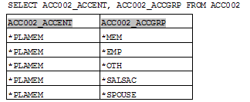
Selecting All or Specific Columns
To select all columns in a table, rather than enumerate each column name in a long list, use the asterisk character (*) in your select list.
In the following example, the asterisk is used with SELECT to retrieve all columns from the Account Entity Group table ACC002:
To select specific columns in a table, specify them in your select list.
© 2008 Australian Administration Services. All rights reserved. Confidential.

Slide 15
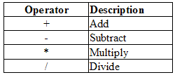
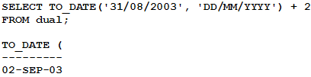
Using Arithmetic expressions and operators
Arithmetic operators can be used with number and date data
Arithmetic operators can be used in any clause other than FROM clause
Operator precedence take into effect when more than one expression is present in an expression. It is (), *, /, +, -
Parenthesis are used to force prioritized evaluation.
Operators of the same priority are evaluated from left to right.
Addition and Subtraction operators can be used with dates – a number represents number of days.
© 2008 Australian Administration Services. All rights reserved. Confidential.

Slide 16
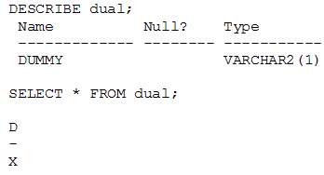
Selecting from the DUAL table
DUAL is a table automatically created by Oracle Database along with the data dictionary.
DUAL is in the schema of the user SYS but is accessible by the name DUAL to all users.
It has one column, DUMMY, defined to be VARCHAR2(1), and contains one row with a value X.
Selecting from the DUAL table is useful for computing a constant expression with the SELECT statement. Because DUAL has only one row, the constant is returned only once.
DONOT CREATE DUAL IN ANY OTHER SCHEMA.
© 2008 Australian Administration Services. All rights reserved. Confidential.

Slide 17
Arithmetic Expression and NULL Value
Arithmetic expression containing a NULL value evaluates to NULL.
Even a division with NULL returns a NULL
This is because NULL is a special value and is not 0 or Blank Space.
The following functions can be used to substitute NULL value.
  NVL : NVL(trn021_dbval,0)
  NVL2 : NVL2(trn021_dbval, trn021_dbval *1.1, trn021_trnval)
  DECODE : decode(trn021_dbval, null,0, trn021_dbval)
  CASE : CASE WHEN trn021_dbval is NOT NULL then trn021_dbval ELSE 0 END;
  COALESE : COALESCE (trn021_dbval,0)
© 2008 Australian Administration Services. All rights reserved. Confidential.

Slide 18
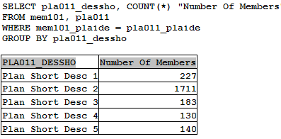
Using Column Aliases
A Column Alias
  Replaces column header
  Is useful with calculations
  Immediately follows the column name. An optional AS keyword can be used between the column name and the alias.
  Requires double quotation marks if it contains spaces or special characters or is case sensitive
© 2008 Australian Administration Services. All rights reserved. Confidential.

Slide 19
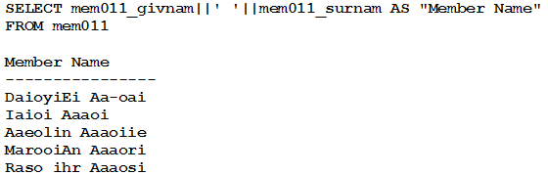
Merging Column Output using Concatenation
A concatenation operator Merges the display of columns or character strings
It is represented by two vertical bars “||”
The resultant column is a character expression
In the example below member given name is concatenated to a blank space and member surname.
The blank space is a character literal and is enclosed within single quotes
© 2008 Australian Administration Services. All rights reserved. Confidential.

Slide 20
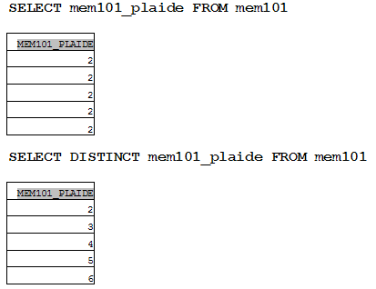
Displaying Distinct Rows
By default all queries display all rows including duplicate rows.
Eliminate duplicate rows by using the DISTINCT keyword in the SELECT statement.
© 2008 Australian Administration Services. All rights reserved. Confidential.

Slide 21
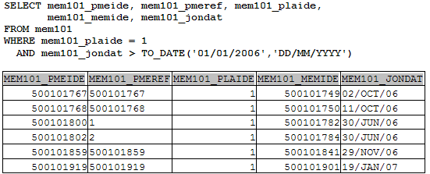
Filtering Rows using a WHERE Clause
WHERE clause in a SELECT statement is used to filter the rows returned from the database.
The WHERE clause follows the FROM clause.
The WHERE clause is followed by a condition which must be satisfied to be TRUE for the ROWS to return.
The condition is composed of column names, expressions, constants and a comparison operator.
The SQL below filters rows for member who joined after 1/1/2006 belonging to plan id 1.
© 2008 Australian Administration Services. All rights reserved. Confidential.

Slide 22
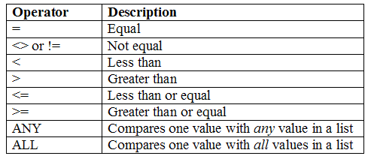
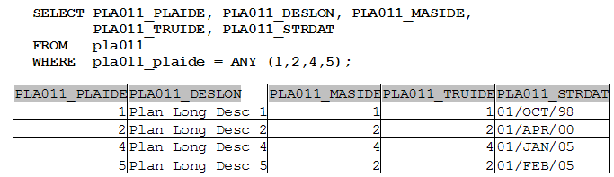
Comparison Conditions
Comparison conditions in WHERE clause are listed below:
The Following example illustrates the use of the condition ANY
© 2008 Australian Administration Services. All rights reserved. Confidential.

Slide 23
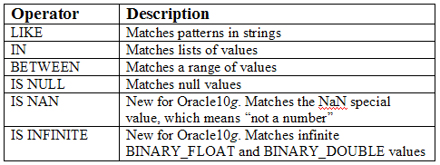
SQL Conditions
The SQL conditions limits rows based on pattern matching of strings, lists of values, ranges of values, and null values.
The SQL conditions are listed in the following table:
The NOT condition is used to reverse the meaning of LIKE, IN, BETWEEN, and IS NULL. The usage is NOT LIKE, NOT IN, MOT BETWEEN, IS NOT NULL, IS NOT NAN, IS NOT INFINITE.
© 2008 Australian Administration Services. All rights reserved. Confidential.

Slide 24
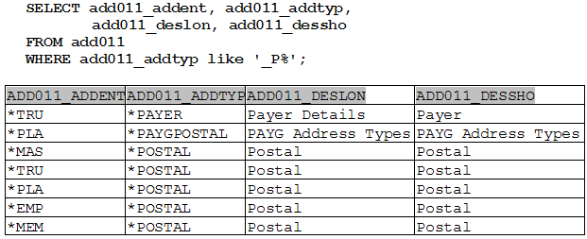
Wildcard search using LIKE
The LIKE condition in a WHERE clause is used to match patterns.
Patterns are specified using a combination of normal characters and the following two wildcard characters:
  Underscore character (_) Matches one character in a specified position
  Percent character (%) Matches any number of characters beginning at the specified position
© 2008 Australian Administration Services. All rights reserved. Confidential.

Slide 25
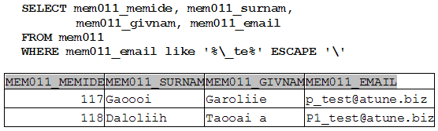
Wildcard search and ESCAPE
To perform a text match on the actual underscore “_” or percent “%” characters in a string, use the ESCAPE option.
The following example retrieves the member details where the email address has an underscore “_”
The ESCAPE option specifies that the backslash character precedes any wildcard characters used with the LIKE operator—in this example, the underscore “_” is the wildcard used.
The underscore is then used in the text match, rather than being treated as a wildcard character as would otherwise be the case.
© 2008 Australian Administration Services. All rights reserved. Confidential.

Slide 26
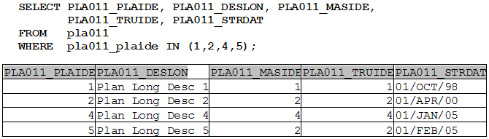
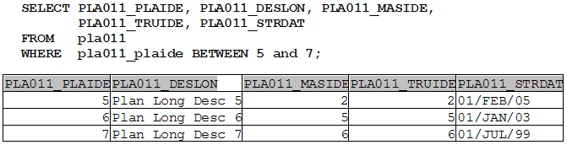
The IN and BETWEEN condition
Use IN condition to test for values in a list
Use the BETWEEN condition to display rows based on a range of values
© 2008 Australian Administration Services. All rights reserved. Confidential.

Slide 27
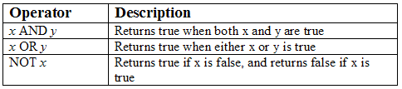
Using the LOGICAL operators
There are three logical operators that may be used in a WHERE clause.
The logical operators allow you to limit rows based on logical conditions. These are listed in the following table:
If you combine AND and OR in the same expression, the AND operator takes precedence over the OR operator .
The comparison operators take precedence over AND.
You can override the precedence using parentheses.
SELECT mem011_memide, mem011_surnam, mem011_dob, mem011_pho
FROM mem101
WHERE mem011_dob > to_date(’01/01/1070’,’DD/MM/YYYY)
OR mem011_memide < 100
AND mem011_surnam like ‘S%’;
The WHERE clause actually works like
WHERE mem011_dob > to_date(’01/01/1070’,’DD/MM/YYYY)
OR (mem011_memide < 100 AND mem011_surnam like ‘S%’);
© 2008 Australian Administration Services. All rights reserved. Confidential.

Slide 28
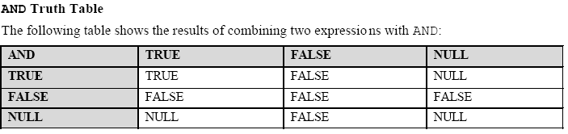
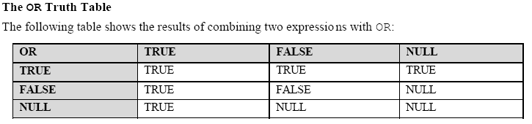
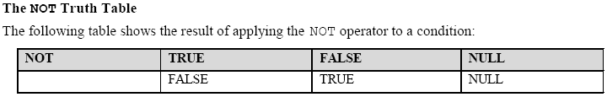
TRUTH Table for logical operators
A TRUTH table lists combination of the results of the two component conditions that produces a single result
A row is returned if the overall result of the condition is TRUE.
© 2008 Australian Administration Services. All rights reserved. Confidential.

Slide 29
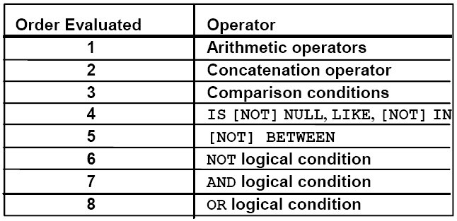
Rules of Precedence in a nutshell
The rules of precedence determine the order in which the expressions are evaluated and calculated.
The following table lists the default order of precedence:
Override the rules of precedence by using parentheses.
© 2008 Australian Administration Services. All rights reserved. Confidential.

Slide 30
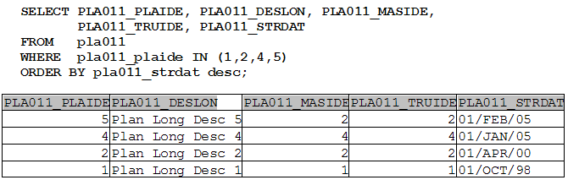

The ORDER BY clause
Sort rows with the ORDER BY clause
  ASC : ascending order is the default
  DESC : descending order
The ORDER BY clause comes last in the SELECT Statement
The column position of the Selected columns can also be specified in the ORDER BY clause. 1 is the first column.
© 2008 Australian Administration Services. All rights reserved. Confidential.

Slide 31
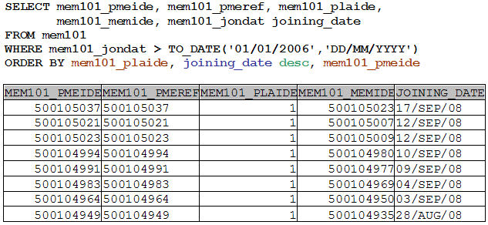
Sorting by multiple columns and alias
For multiple columns, the order of ORDER BY clause is the order of sort.
Column alias can also be used in the order by clause.
Default sort order is Ascending.
© 2008 Australian Administration Services. All rights reserved. Confidential.

Slide 32
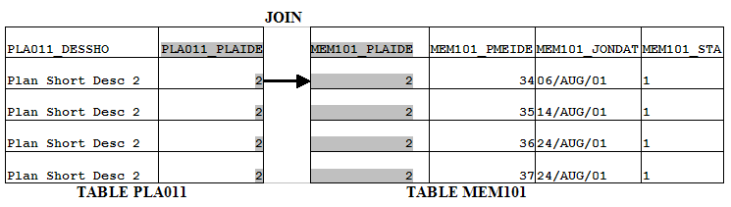

Data from Multiple Tables
A Database generally has more than one table from where data is required.
When two or more tables are required to obtain data, the tables are joined on columns that exist and relate to both the tables.
In the example below, Plan Id exists in both PLA011 and MEM101 and is used to join the tables
Join Condition is written in the WHERE clause.
© 2008 Australian Administration Services. All rights reserved. Confidential.

Slide 33
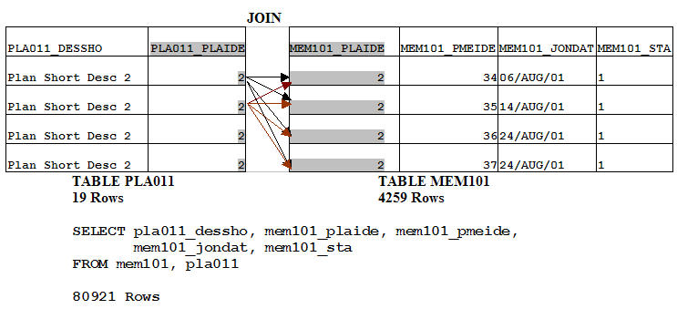
Cartesian Products
A Cartesian Product is formed when
  A join condition is omitted
  A join condition is invalid
  All rows in the first tables are joined to all rows in the second table
To avoid a Cartesian Product always include a valid join condition in a WHERE clause.
© 2008 Australian Administration Services. All rights reserved. Confidential.

Slide 34
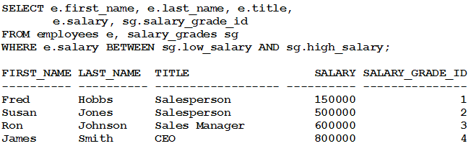
Join Conditions
There are two of join conditions, which are based on the operator used in the join:
  Equijoins : The equality operator (=) is used in the join.
  Non-equijoins : An operator other than equals in the join, such as <, >, BETWEEN, and so on are used.
© 2008 Australian Administration Services. All rights reserved. Confidential.

Slide 35
Join Types
In addition to the join condition, there are also three different types of joins:
  Inner joins Return a row only when the columns in the join contain values that satisfy the join condition.
  Outer joins Can return a row even when one of the columns in the join condition contains a null value.
  Self joins Return rows joined on the same table.
© 2008 Australian Administration Services. All rights reserved. Confidential.

Slide 36
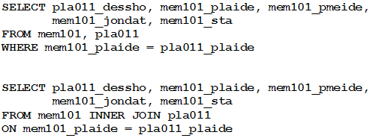
Inner Joins
Return a row only when the columns in the join contain values that satisfy the join condition.
If a row has a null value in one of the columns in the join condition, that row isn’t returned.
The second example uses the SQL 1999 JOIN Syntax
© 2008 Australian Administration Services. All rights reserved. Confidential.

Slide 37
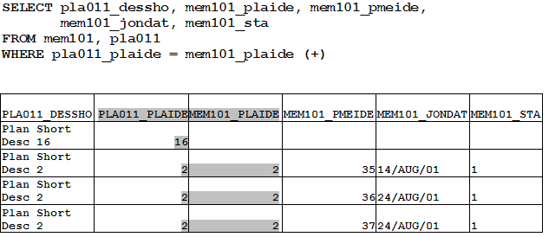
Outer Joins
Can return a row even when one of the columns in the join condition contains a null value.
Oracle’s deployment uses a (+) and has no facility for FULL OUTER JOIN. It can only be either LEFT OUTER JOIN or RIGHT OUTER JOIN.
© 2008 Australian Administration Services. All rights reserved. Confidential.

Slide 38
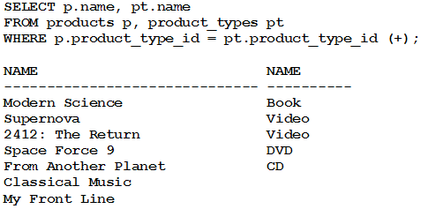
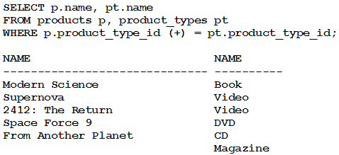
Outer Joins
Example of Left Outer Join:
Example of Right Outer Join:
© 2008 Australian Administration Services. All rights reserved. Confidential.

Slide 39
Limitations on Outer Joins
Following are limitations on using outer joins
  the outer join operator can only be placed on one side of the join
  WHERE p.product_type_id (+) = pt.product_type_id (+)
  an outer join condition cannot be used with the IN operator
  WHERE p.product_type_id (+) IN (1, 2, 3, 4)
  You cannot use an outer join condition with another join using the OR operator
  WHERE p.product_type_id (+) = pt.product_type_id
  OR p.product_type_id = 1;
© 2008 Australian Administration Services. All rights reserved. Confidential.

Slide 40
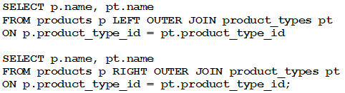
Outer Join – SQL 99 Syntax
Introduces FROM table1 { LEFT | RIGHT | FULL } OUTER JOIN table2
  where
  table1 and table2 specify the tables that you want to join.
  LEFT specifies you want to perform a left outer join.
  RIGHT specifies you want to perform a right outer join.
  FULL specifies you want to perform a full outer join; a full outer join uses all rows in table1 and table2 including those that have null values in the columns used in the join.
Example of Left and Right outer joins :
© 2008 Australian Administration Services. All rights reserved. Confidential.

Slide 41
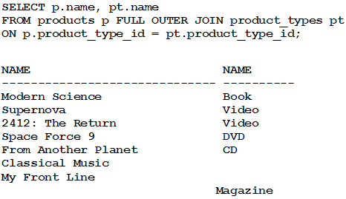
FULL Outer Join
A full outer join uses all rows in the joined tables including those that have null values in either of the columns used in the join.
© 2008 Australian Administration Services. All rights reserved. Confidential.

Slide 42
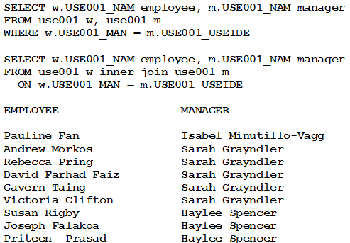
Self Joins
A self join is a join made on the same table.
To perform a self join, a different table alias must be used to identify each reference of the table used in the query.
Following example illustrates the usage in the old style and SQL 99 .
USE001 table is referenced twices to get the worker / manager details
© 2008 Australian Administration Services. All rights reserved. Confidential.

Slide 43
SQL Functions
There are two main types of functions you can use in an Oracle database:
  Single row functions These operate on one row at a time and return one row of output for each input row.
    An example single row function is CONCAT(x, y), which appends y to x and returns the resulting string.
  Aggregate functions These operate on multiple rows at the same time and return one row of output.
    An example aggregate function is AVG(x), which returns the average of x where x may be a column or, more generally, an expression.
© 2008 Australian Administration Services. All rights reserved. Confidential.

Slide 44
Single Row Functions
You use single row functions when you want to perform an operation on one row at a time and get one row of output for each row. There are five main types of single row functions:
  Character Functions Allow you to manipulate strings of characters and return strings or numbers.
  Numeric Functions Allow you to perform calculations and return numbers.
  Conversion Functions Allow you to convert a value from one data type to another.
  Date functions Allow you to process dates and times.
  Regular expression functions Allow you to use regular expressions when searching data. These functions are new for Oracle Database 10g.
© 2008 Australian Administration Services. All rights reserved. Confidential.

Slide 45
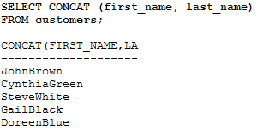
Character Functions
These functions accept character input, which may come from a column in a table or, more generally, from any expression.
This input is then processed in some way and a result returned.
One example function is UPPER(), which converts all the letters in a character string to uppercase and returns the new string.
A few popular character functions are provided. The complete list is available in Oracle Manual.
CONCAT()
  - You use CONCAT(x, y) to append y to x. CONCAT() then returns the resulting string.
© 2008 Australian Administration Services. All rights reserved. Confidential.

Slide 46
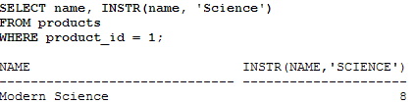
Character Functions
INITCAP()
  You use INITCAP(x) to convert the initial letter of each word in x to uppercase.
INSTR()
  You use INSTR(x, find_string [, start] [, occurrence]) to search for find_string in x.
  INSTR() returns the position at which find_string occurs.
  The optional start position allows you to specify the position to start the search in x.
  You can also supply an optional occurrence that indicates which occurrence of find_string should be returned.
© 2008 Australian Administration Services. All rights reserved. Confidential.

Slide 47
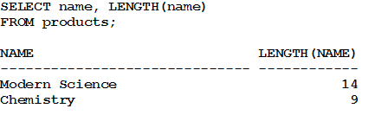
Character Functions
LENGTH()
  You use LENGTH(x) to get the number of characters in x.
LOWER() and UPPER()
  You use LOWER(x) to convert the letters in x to lowercase. Similarly, you use UPPER(x) to convert the letters in x to uppercase.
LPAD() and RPAD()
  You use LPAD(x, width [, pad_string]) to pad x with spaces to left to bring the total length of the string up to width characters. Similarly RpAD is to pad to the right.
LTRIM(), RTRIM(), and TRIM()
  You use LTRIM(x [, trim_string]) to trim characters from the left of x. Similarly, you use RTRIM() to trim characters from the right of x. You use TRIM() to trim characters from the left and right of x.
© 2008 Australian Administration Services. All rights reserved. Confidential.

Slide 48
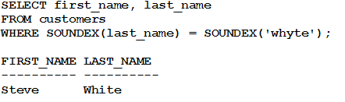
Character Functions
NVL() and NVL2() have been discussed earlier
REPLACE()
  You use REPLACE(x, search_string, replace_string) to search x for search_string and replace it with replace_string.
SOUNDEX()
  You use SOUNDEX(x) to get a string containing the phonetic representation of x.
SUBSTR()
  You use SUBSTR(x, start [, length]) to return a substring of x that begins at the position specified by start.
  SELECT substr('MY NAME IS SUJAN',1,7) SUB from DUAL;
    SUB
    -------
    MY NAME
© 2008 Australian Administration Services. All rights reserved. Confidential.

Slide 49
Numeric Functions
You use the numeric functions to perform calculations.
These functions accept an input number, which may come from a column in a table or from an expression that evaluates to a number.
A calculation is performed with this input and a number is returned.
An example of a numeric function is SQRT(), which returns the square root of the input number.
A few popular numeric functions are discussed. The complete list is available in Oracle Manual.
MOD()
  You use MOD(x, y) to get the remainder when x is divided by y.
ROUND()
  You use ROUND(x, [y]) to get the result of rounding x an optional y decimal places.
TRUNC()
  You use TRUNC(x, [y]) to get the result of truncating the number x to an optional y decimal places.
© 2008 Australian Administration Services. All rights reserved. Confidential.

Slide 50
Conversion Function
Sometimes you might want to convert a value from one data type to another.
Some of the commonly used conversion functions are:
TO_CHAR(x [, format])
  Converts x to a VARCHAR2 string. You can supply an optional format that indicates the format of x.
TO_DATE(x [, format])
  Converts x to a DATE.
TO_NUMBER(x [, format])
  Converts x to a NUMBER.
TRANSLATE(x, from_string, to_string)
  Converts all occurrences of from_string in x to to_string.
© 2008 Australian Administration Services. All rights reserved. Confidential.

Slide 51
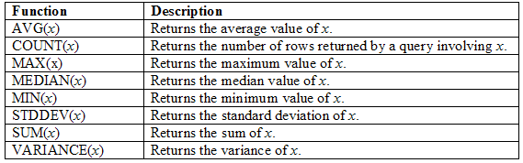
Aggregate Functions
aggregate functions operate on a group of rows at the same time and return one row of output for each group of rows.
Aggregate functions are also known as group functions because they operate on groups of rows.
The aggregate functions are mainly numerical, and you typically use them to return a value based on a set of values contained in columns of rows.
© 2008 Australian Administration Services. All rights reserved. Confidential.

Slide 52
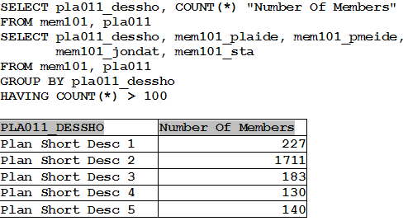
GROUP BY Clause for grouping rows
Sometimes you might want to group blocks of rows in a table and get some information on those groups of rows.
The GROUP BY clause is used to group similar rows together.
HAVING clause is used to filter groups of rows
© 2008 Australian Administration Services. All rights reserved. Confidential.

Slide 53
Subqueries
It is possible to place a SELECT statement within an outer SELECT, UPDATE, or DELETE statement. The inner SELECT statement is known as a subquery.
There are two basic types of subqueries:
  Single row subqueries Return zero or one row to the outer SQL statement.
  Multiple row subqueries Return one or more rows to the outer SQL statement.
In addition, there are three subtypes of subqueries that may return single or multiple rows:
  Multiple column subqueries Return more than one column to the outer SQL statement.
  Correlated subqueries Reference one or more columns in the outer SQL statement. The subquery is known as a correlated subquery because the subquery is related to the outer SQL statement.
  Nested subqueries Are placed within another subquery. You can nest subqueries to a depth of 255.
© 2008 Australian Administration Services. All rights reserved. Confidential.

Slide 54
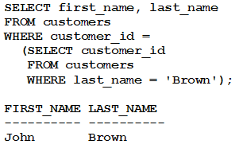
Single Row Subqueries
A single row subquery is one that returns zero or one row to the outer SQL statement.
It is possible to place a subquery in a WHERE clause, a HAVING clause, or a FROM clause of a SELECT statement.
Subqueries in a WHERE Clause
© 2008 Australian Administration Services. All rights reserved. Confidential.

Slide 55
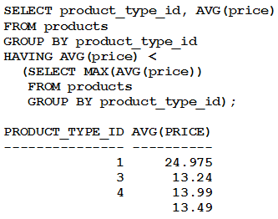
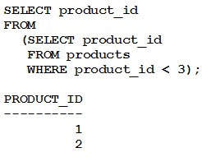
Single Row Subqueries
Subqueries in a HAVING Clause
Subqueries in a FROM Clause (Inline Views)
© 2008 Australian Administration Services. All rights reserved. Confidential.

Slide 56

Multiple Row Subquery
Multiple row subquery is used to return one or more rows to the outer SQL statement.
To handle a subquery that returns multiple rows, the outer query may use the IN, ANY, or ALL operator.
Using IN with a Multiple Row Subquery
© 2008 Australian Administration Services. All rights reserved. Confidential.

Slide 57


Multiple Row Subquery
Using ANY with a Multiple Row Subquery
the ANY operator is used to compare a value with any value in a list. You must place an =, <>, <, >, <=, or >= operator before ANY in your query.
Using ALL with a Multiple Row Subquery
the ALL operator is used to compare a value with any value in a list. You must place an =, <>, <, >, <=, or >= operator before ALL in your query.
© 2008 Australian Administration Services. All rights reserved. Confidential.

Slide 58

Multiple Column Subqueries
subqueries can be written that return multiple columns.
© 2008 Australian Administration Services. All rights reserved. Confidential.

Slide 59

Correlated Subqueries
A correlated subquery references one or more columns in the outer query.
The subquery is known as a correlated subquery because the subquery is related to the outer query.
© 2008 Australian Administration Services. All rights reserved. Confidential.

Slide 60

Correlated Subqueries
Using EXISTS and NOT EXISTS with a Correlated Subquery
The EXISTS operator is used to check for the existence of rows returned by a subquery.
© 2008 Australian Administration Services. All rights reserved. Confidential.

Slide 61


Correlated Subqueries and Update and Delete
Writing an UPDATE Statement Containing a Subquery
Writing a DELETE Statement Containing a Subquery
© 2008 Australian Administration Services. All rights reserved. Confidential.

Slide 62

Oracle Data Types (Character)
The data types available in ORACLE are listed in the next few slides:
© 2008 Australian Administration Services. All rights reserved. Confidential.

Slide 63

Oracle Data Types (Numeric)
© 2008 Australian Administration Services. All rights reserved. Confidential.

Slide 64

Oracle Data Types (Dates)
© 2008 Australian Administration Services. All rights reserved. Confidential.

Slide 65

Oracle Data Types (Special)
© 2008 Australian Administration Services. All rights reserved. Confidential.

Slide 66
How is SQL Processed By the Database
SQL Statement
Output
Parser
Soft Parse
Hard Parse
Optimizer
RBO (< 10g)
Statistics
Row Source Generator
SQL Execution
CBO
© 2008 Australian Administration Services. All rights reserved. Confidential.

Slide 67
Better SQL – Tip #1
Make use of the available index
  Don't perform operations on database objects referenced in the WHERE clause – Oracle will ignore the index
Do Not Use
Use
SELECT TRN511_ENTTYP, TRN511_ENTIDE, TRN511_TRNEFF
FROM TRN511
WHERE UPPER(TRN511_ENTTYP) = ‘*PLA';
SELECT TRN511_ENTTYP, TRN511_ENTIDE, TRN511_TRNEFF
FROM TRN511
WHERE TRN511_ENTTYP = ‘*PLA';
SELECT TRN511_ENTTYP, TRN511_ENTIDE, TRN511_ TRNEFF
FROM TRN511
WHERE TRN511_ENTTYP = NVL ( :1, TRN511_ENTTYP);
SELECT TRN511_ENTTYP, TRN511_ENTIDE, TRN511_TRNEFF
FROM TRN511
WHERE TRN511_ENTTYP LIKE NVL ( :1, ‘%’);
SELECT TRN511_ENTTYP, TRN511_ENTIDE, TRN511_ TRNEFF
FROM TRN511
WHERE TRUNC (TRN511_TRNEFF) = TRUNC (SYSDATE);
SELECT TRN511_ENTTYP, TRN511_ENTIDE, TRN511_ TRNEFF
FROM TRN511
WHERE TRN511_TRNEFF >= TRUNC (SYSDATE) AND TRN511_TRNEFF < TRUNC (SYSDATE) + 1;
© 2008 Australian Administration Services. All rights reserved. Confidential.

Slide 68
Better SQL – Tip #1
  Don't perform operations on database objects referenced in the WHERE clause – Oracle will ignore the index
Do Not Use
Use
SELECT TRN511_ENTTYP, TRN511_ENTIDE, TRN511_ TRNEFF
FROM TRN511
WHERE TRN511_ENTTYP || TRN511_TRNSTA = ‘*PLA1';
SELECT TRN511_ENTTYP, TRN511_ENTIDE, TRN511_ TRNEFF
FROM TRN511
WHERE TRN511_ENTTYP = ‘*PLA'
AND TRN511_TRNSTA = ‘1';
SELECT TRN511_ENTTYP, TRN511_ENTIDE, TRN511_ TRNEFF
FROM TRN511
WHERE TRN511_PSTVAL + 3000 < 5000;
SELECT TRN511_ENTTYP, TRN511_ENTIDE, TRN511_ TRNEFF
FROM TRN511
WHERE TRN511_PSTVAL < 2000;
SELECT TRN511_ENTTYP, TRN511_ENTIDE, TRN511_ TRNEFF
FROM TRN511
WHERE TRN511_PSTVAL <> 0;
SELECT TRN511_ENTTYP, TRN511_ENTIDE, TRN511_ TRNEFF
FROM TRN511
WHERE TRN511_PSTVAL > 0;
SELECT TRN511_ENTTYP, TRN511_ENTIDE, TRN511_ TRNEFF
FROM TRN511
WHERE TRN511_PSTVAL NOT = 0;
SELECT TRN511_ENTTYP, TRN511_ENTIDE, TRN511_ TRNEFF
FROM TRN511
WHERE TRN511_PSTVAL > 0;
© 2008 Australian Administration Services. All rights reserved. Confidential.

Slide 69
Better SQL – Tip #2
Share SQL statement. If SQL is not shared, it will take up too much resource parsing. We have this issue in EDI processing.
Non-sharable SQL
insert into EDI020 (edi020_sta,edi020_ediseq,edi020_pmeide,edi020_ediide) values ('0',44979,NULL,900006307)
insert into EDI020 (edi020_sta,edi020_ediseq,edi020_pmeide,edi020_ediide) values ('0',44906,NULL,900006307)
Sharable SQL
insert into EDI020 (edi020_sta,edi020_ediseq,edi020_pmeide,edi020_ediide) values (:B1,:B2,:B3,:B4)
Bind value: b1=’0’
b2=44979
b3 = NULL
b4 = 900006307
insert into EDI020 (edi020_sta,edi020_ediseq,edi020_pmeide,edi020_ediide) values (:B1,:B2,:B3,:B4)
Bind value: b1=’0’
b2=44906
b3 = NULL
b4 = 900006307
© 2008 Australian Administration Services. All rights reserved. Confidential.

Slide 70
Better SQL – Tip #3
Don't forget to tune views. Views are SELECT statements and can be tuned in just the same way as any other type of SELECT statement can be. All tuning applicable to any SQL statement are equally applicable to views.
Some of them unnecessarily have multi table lookups and outer joins
Eg MEMORPMEVIEW
CREATE OR REPLACE VIEW ATU_DATA.MEMORPMEVIEW3
as
SELECT /*+ FIRST_ROWS */ '*PLAMEM' as entity
, mem101.mem101_memide as memide
, mem101.mem101_plaide as plaide
, mem101.mem101_pmeide as pmeide
, mem101.mem101_pmeref as pmeref
, mem011.mem011_surnam as surnam
, mem011.mem011_givnam as givnam
, mem011.mem011_dob as dob
, mem011.mem011_sexide as gender
, pla011.pla011_deslon as plades
, mem101.mem101_sta as sta
FROM mem101, pla011, mem011
WHERE mem101_plaide = pla011_plaide
AND mem101_memide (+) = mem011_memide
ORDER BY mem101.mem101_pmeide ;
© 2008 Australian Administration Services. All rights reserved. Confidential.

Slide 71
Better SQL – Tip #4
Know the database table structure and column data type. This will simplify the SQL you are writing
Unnecessary Function calls
select NVL(MIN(TO_NUMBER(edi024_sta)), 0)
from edi024 where edi024_ediide = :1
EDI024_STA is a NOT NULL Column
Change to
select MIN(edi024_sta)
from edi024 where edi024_ediide = :1
MIN can be used for VARCHAR2 Columns
© 2008 Australian Administration Services. All rights reserved. Confidential.

Slide 72
Better SQL – Tip #5
Should be in WHERE not HAVING
HAVING clauses should only be used when columns with aggregate operations applied to them are restricted by the clause.
Do Not Use
Use
SELECT region, AVG (loc_size)
FROM location
GROUP BY region
HAVING region != 'SYDNEY'
AND region != 'PERTH';
SELECT region, AVG (loc_size)
FROM location
WHERE region != 'SYDNEY'
AND region != 'PERTH';
GROUP BY region;
© 2008 Australian Administration Services. All rights reserved. Confidential.

Slide 73
Better SQL – Tip #6
Minimize the number of table lookups (subquery blocks) in queries, particularly if your statements include subquery SELECTs or multicolumn UPDATEs.
Multiple table calls
SELECT fmu013_effdat, MAX(fmu013_effseq) AS seq
FROM FMU013
WHERE fmu013_fmuent = '*PLAMEM'
AND fmu013_fmuide = 'MAST1_1001'
AND fmu013_effdat <= to_date('2007-01-10', 'YYYY-MM-DD')
AND fmu013_effdat IN (
SELECT fmu013_effdat
FROM FMU013
WHERE fmu013_sta = '1'
AND fmu013_fmuent = '*PLAMEM'
AND fmu013_fmuide = 'MAST1_1001'
AND fmu013_effseq IN (
SELECT MAX(fmu013_effseq)
FROM FMU013
WHERE fmu013_fmuent = '*PLAMEM'
AND fmu013_fmuide = 'MAST1_1001'
GROUP BY fmu013_effdat
)
)
GROUP BY fmu013_effdat
ORDER BY fmu013_effdat DESC, seq DESC
/
© 2008 Australian Administration Services. All rights reserved. Confidential.

Slide 74
Better SQL – Tip #6
Minimize the number of table lookups (subquery blocks) in queries, particularly if your statements include subquery SELECTs or multicolumn UPDATEs.
Single Table Call
select fmu013_effdat, max_effseq
from
( select fmu013_effdat, MAX(fmu013_effseq) over ( partition by
fmu013_fmuent, fmu013_fmuide, fmu013_effdat ) max_effseq,
fmu013_sta, fmu013_effseq
FROM FMU013
where fmu013_fmuent = '*PLAMEM'
AND fmu013_fmuide = 'MAST1_1001'
)
where fmu013_effdat <= to_date('2007-01-10', 'YYYY-MM-DD')
and fmu013_sta = 1
and fmu013_effseq = max_effseq
/
© 2008 Australian Administration Services. All rights reserved. Confidential.

Slide 75
Better SQL – Tip #7
EXISTS, IN-LIST OR TABLE JOIN for Subqueries?
Consider the alternatives EXISTS, IN and table joins when doing multiple table joins.
None of these are consistently faster; it depends on your data.
IN
EXISTS
Query
Select * from T1 where x in ( select y from T2 )
select * from t1 where exists ( select null from t2 where y = x )
Processed as
select *
from t1, ( select distinct y from t2 ) t2
where t1.x = t2.y;
for x in ( select * from t1 )
loop
if ( exists ( select null from t2 where y = x.x )
then
OUTPUT THE RECORD
end if
end loop
What it means
The subquery is evaluated, distinct'ed, indexed (or hashed or sorted) and then joined to the original table -- typically.
whereas the first query can make use of an index on T1(x).
It always results in a full scan of T1
It will use an index on T2(y)
Where it is used?
When the result of the subquery is small
When the result of the subquery ( select y from T2 ) is "huge" and takes a long time. But the table T1 is relatively small.
Use Either?
When size of T1 is same as T2
© 2008 Australian Administration Services. All rights reserved. Confidential.

Slide 76
Better SQL – Tip #8
EXISTS, IN-LIST OR TABLE JOIN for Co-related Subqueries?
Consider the alternatives EXISTS, IN and table joins when doing multiple table joins.
IN and EXISTS work similarly in co-related subqueries when the subquery uses an index and returns few rows.
JOIN
EXISTS
IN LIST
select adj011.*
from adj011, adj012
where
adj011_heaide = adj012_heaide and
adj012_linide is null and
(adj011_sta IN ('0', '1', '2' ) )
order by adj011_heaide asc
select adj011.*
from adj011
where exists (select 1 from adj012 where
adj011_heaide = adj012_heaide and
adj012_linide is null )
and (adj011_sta IN ('0', '1', '2' ) )
order by adj011_heaide asc
select adj011.*
from adj011
where adj011_heaide in (select adj012_heaide from adj012 where
adj011_heaide = adj012_heaide and
adj012_linide is null )
and (adj011_sta IN ('0', '1', '2' ) )
order by adj011_heaide asc
© 2008 Australian Administration Services. All rights reserved. Confidential.

Slide 77
Better SQL – Tip #9
NOT IN and NOT EXISTS may not be the same – use wisely
It depends if the joining column values are null
If values are null use NOT EXISTS
If values are NOT NULL, NOT IN will perform better.
© 2008 Australian Administration Services. All rights reserved. Confidential.

Slide 78
Better SQL – Tip #10
Avoid the DISTINCT qualifier on the SELECT list in queries at the owner end of a one-to-many relationship.
The DISTINCT operator causes Oracle to fetch all rows satisfying the table join and then sort and filter out duplicate values.
EXISTS is a faster alternative, because the Oracle optimizer realizes when the subquery has been satisfied once, there is no need to proceed further and the next matching row can be fetched.
Do Not Use
Use
Select DISTINCT mem011_memide, mem011_surname, mem011_givnam
from mem011, mem101
Where mem101_memide = mem011_memide
And mem101_plaide = :b1
Select mem011_memide, mem011_surname, mem011_givnam
from mem011
Where exists (select ‘X’ from mem101
Where mem101_memide = mem011_memide
And mem101_plaide = :b1);
© 2008 Australian Administration Services. All rights reserved. Confidential.

Slide 79
Better SQL – Tip #11
Outer Joins are very powerful and if suitably used can reduce the number of table lookups.
Avoid Outer joins that are not necessary and confusing to you and the optimiser -
SELECT /*+ FIRST_ROWS */ '*PLAMEM' as entity
, mem101.mem101_memide as memide
, mem101.mem101_plaide as plaide
, mem101.mem101_pmeide as pmeide
, mem101.mem101_pmeref as pmeref
, mem011.mem011_surnam as surnam
, mem011.mem011_givnam as givnam
, mem011.mem011_dob as dob
, mem011.mem011_sexide
, pla011.pla011_deslon as plades
, mem101.mem101_sta as sta
FROM mem101, pla011, mem011
WHERE mem101_plaide = pla011_plaide
AND mem101_memide(+) = mem011_memide
© 2008 Australian Administration Services. All rights reserved. Confidential.

Slide 80
Better SQL – Tip #12
If the results fed into a UNION are known to be unique, replace UNION with UNION ALL
UNION in a SQL query will combine the results of two sub-queries, filtering out any duplicates.
Replacing UNION with UNION ALL will just return the combined results without checking for duplicates; less work for the database!
Replace
With Union ALL
SELECT edi070_ediide, edi070_ediseq, edi070_actunt, edi070_sta
FROM edi070, trd021, trn021, mem101, mem011, inv013
WHERE ………………
AND (edi070_sta = '2' or edi070_sta = '3')
UNION
SELECT edi070_ediide, edi070_ediseq, edi070_actunt, edi070_sta,
FROM edi070, mem101, mem011
WHERE ……………
AND(edi070_sta <> '2' and edi070_sta <> '3')
SELECT edi070_ediide, edi070_ediseq, edi070_actunt, edi070_sta
FROM edi070, trd021, trn021, mem101, mem011, inv013
WHERE edi070_trnide = trd021_trnide
AND ………………
AND (edi070_sta = '2' or edi070_sta = '3')
UNION ALL
SELECT edi070_ediide, edi070_ediseq, edi070_actunt, edi070_sta,
FROM edi070, mem101, mem011
WHERE ………
AND(edi070_sta <> '2' and edi070_sta <> '3')
© 2008 Australian Administration Services. All rights reserved. Confidential.

Slide 81
Better SQL – Tip #13
Use DECODE or CASE and scalar subqueries to selectively select from different tables/rows in a single query
SELECT trn511_plaide, trn511_enttyp, trn511_entide, trn511_pstdat,
(CASE trn511_trngrp
WHEN '*CLM'
THEN (SELECT clm005_dessho
FROM clm011, clm005
WHERE trn511_trnide = clm011_trnide
AND trn511_plaide = clm005_plaide
AND clm005_clmtyp = clm011_clmtyp)
WHEN ………..
WHEN '*FEE'
THEN (SELECT fee011_dessho
FROM fee011
WHERE trn511_trncde = fee011_feetyp
AND trn511_enttyp = fee011_feeent)
ELSE 'Not Applicable'
END
) shortdescr
FROM trn511, trn512, trn005, mem101, emp101,......
© 2008 Australian Administration Services. All rights reserved. Confidential.

Slide 82
Better SQL – Tip #14
Beware of Unrestricted Conditions
  MEM101_PMEIDE > :5
There must be a reason for such queries
Check if the application is restricting rows
Original
Modified
Consider this?
select * from mem101 where
(mem101_plaide = :1 and (upper( mem101_sta ) = :2 or
upper( mem101_sta ) = :3) and
mem101_credat < :4 + 1 and mem101_pmeide > :5)
order by mem101_pmeide asc
select * from mem101 where
(mem101_plaide = :1 and (upper( mem101_sta ) = :2 or
upper( mem101_sta ) = :3) and
mem101_credat < :4 + 1 and mem101_pmeide between :5 and :6)
order by mem101_pmeide asc
Select * from (Select a.*, rownum rn from (select * from mem101 where
(mem101_plaide = :1 and (upper( mem101_sta ) = :2 or
upper( mem101_sta ) = :3) and
mem101_credat < :4 + 1) a
order by mem101_pmeide asc ) where rownum <= :5)
where rn >= :6
© 2008 Australian Administration Services. All rights reserved. Confidential.

Slide 83
Better SQL – Tip #15
Oracle automatically performs simple column type conversions (or casting) when it compares columns of different types.
Depending on the type of conversion, indexes may not be used.
Declare your program variables as the same type as your Oracle columns
Data type
Query
After Implicit Conversion
Index Used?
* TRN021_STA NUMBER (INDEXED)
select * from trn021 where trn021_sta = ‘1’;
select * from trn021 where trn021_sta = to_number(‘1’);
YES
TRN021_STA VARCHAR2 (INDEXED)
select * from trn021 where trn021_sta = 1;
select * from trn021 where to_number(trn021_sta) = 1;
NO
© 2008 Australian Administration Services. All rights reserved. Confidential.

Slide 84
Why Tune SQL
SQL Tuning sometime takes even longer than writing and testing the SQL
We however undertake the difficult process of tuning the SQL to :
  Ensure scalability in our application
  Improve the interactive response time of an Oracle based application
  Improve batch throughput
Exponential
  Reduce System load
Constrained
  Avoid hardware upgrades
Performace (resp time / thr put)
Linear
Scalability is a system's ability to process more workload, with a proportional increase in system resource usage.
Nearly Static
Load on the system (no of rows/ users)
Patterns of scalability
© 2008 Australian Administration Services. All rights reserved. Confidential.

Slide 85

Why Tune SQL
approximately 60% of all Oracle system performance problems are resolved by coding optimal SQL.
It is less expensive and can offer greater improvements the earlier its addressed in the SDLC.
It may be the only available tuning measure for production systems
© 2008 Australian Administration Services. All rights reserved. Confidential.

Slide 86
Q & A
Reference:
Oracle SQL Reference – Oracle Documentation
Oracle Database 10g SQL by Jason Price
Oracle SQL – EssentiaL Reference – David C Kreines
Mastering Oracle SQL, 2nd Edition By Alan Beaulieu, Sanjay Mishra
SQL Cookbook, 1st Edition by Anthony Molinaro
© 2008 Australian Administration Services. All rights reserved. Confidential.

